Slide 1
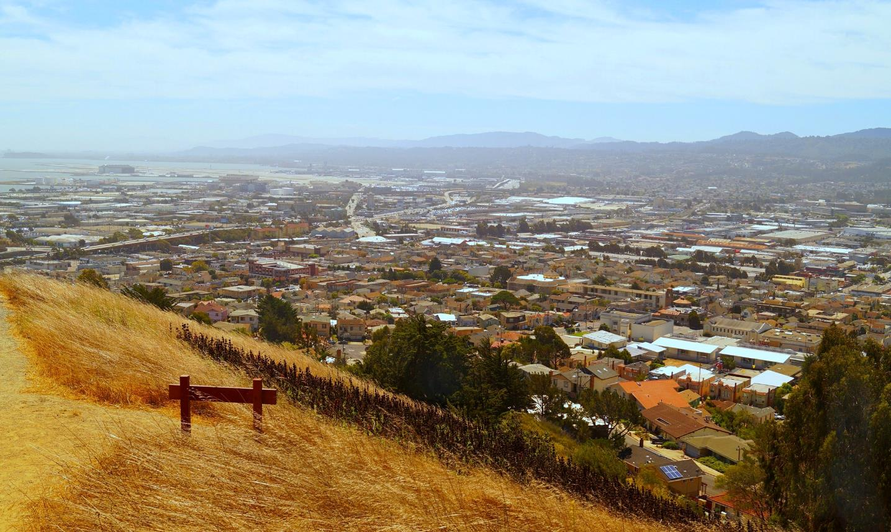
“Any Town” City Council Presentation
Presentation Date

Slide 2
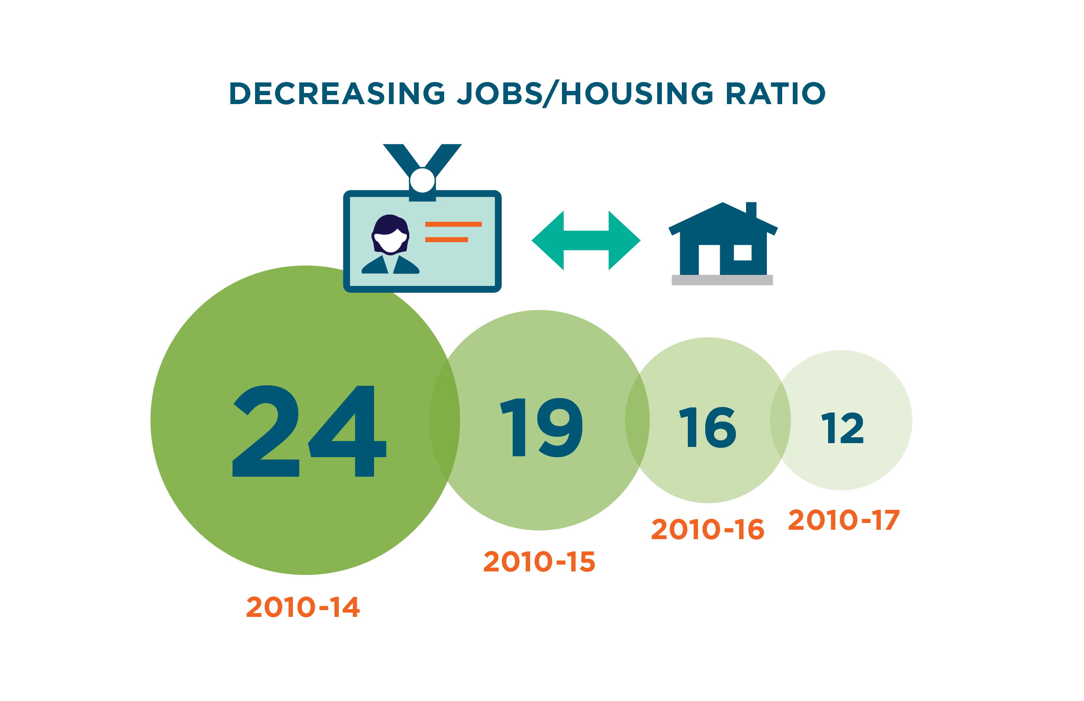
Jobs/Housing Challenge: Closing the Gap
Notes:
While our jobs-housing gap is closing, we still have a long way to go. Right now, we have a 12:1 jobs/housing ratio. While the ultimate goal may not be a 1:1 ratio, but maybe something like 3:1, we are working to bring this number down so that everyone who wants to can call San Mateo County home.
We appreciate the work that you are doing to educate your community about housing and we thank you for your time today.

Slide 3
Home for All Approach
New Housing
Funding
Housing Policies
Land
Community Support

Slide 4
2019 Community Engagement Program
2019 Cities – Cohort 1
Brisbane
San Mateo
2019 Cities – Cohort 2
Foster City
2018 Cities
Burlingame
Half Moon Bay
San Carlos
Redwood City
Portola Valley
Pacifica
Hillsborough

Slide 5
Thank You!
Notes:
Any questions?

